Slide 1
Deep Learning with PyTorch
Seth Juarez
@sethjuarez

Slide 2

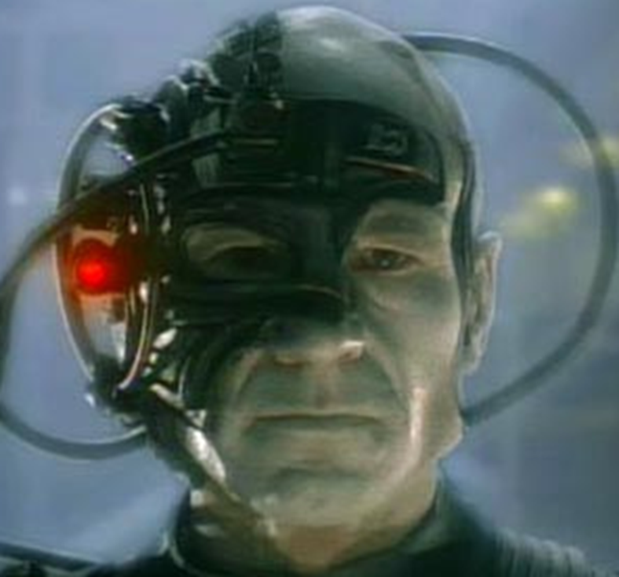


Slide 3
artificial intelligence
machine learning
deep learning

Slide 4

programming
algorithm
answers
input

Slide 5
machine learning
answers
algorithm
input

Slide 6

machine learning
PyTorch
model
data

Slide 7

machine learning
data
PyTorch
model / algorithm
code
answers
input

Slide 8


Slide 9
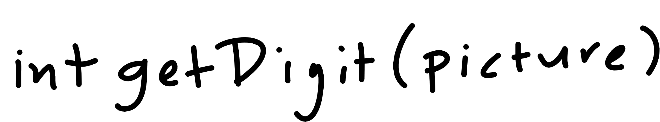

Slide 10

Notes:
Cover the fact that ML uses data to make its own functions

Slide 11
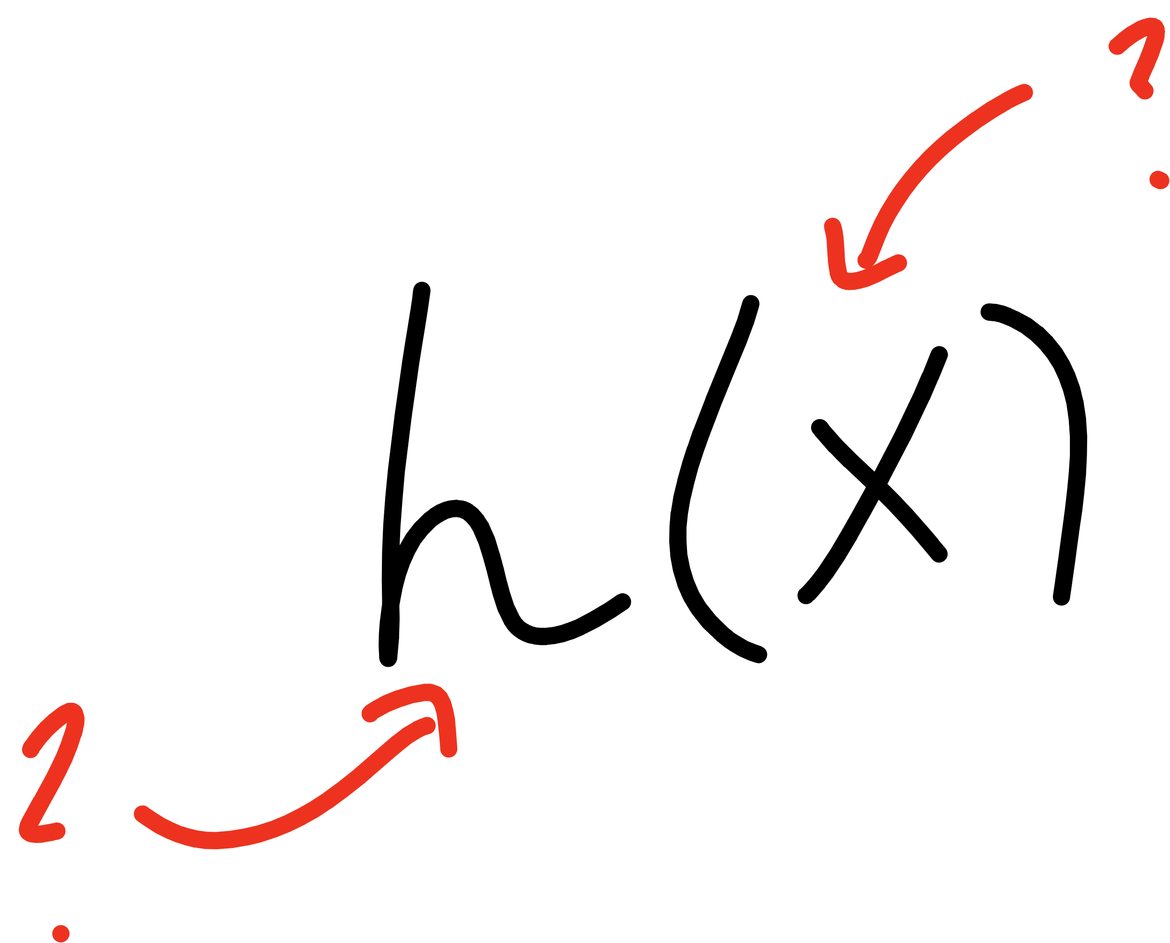
Notes:
Open mnist data representation

Slide 12
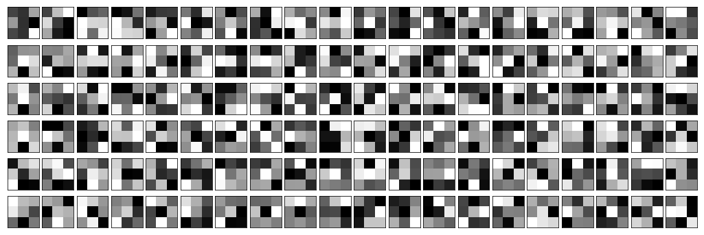
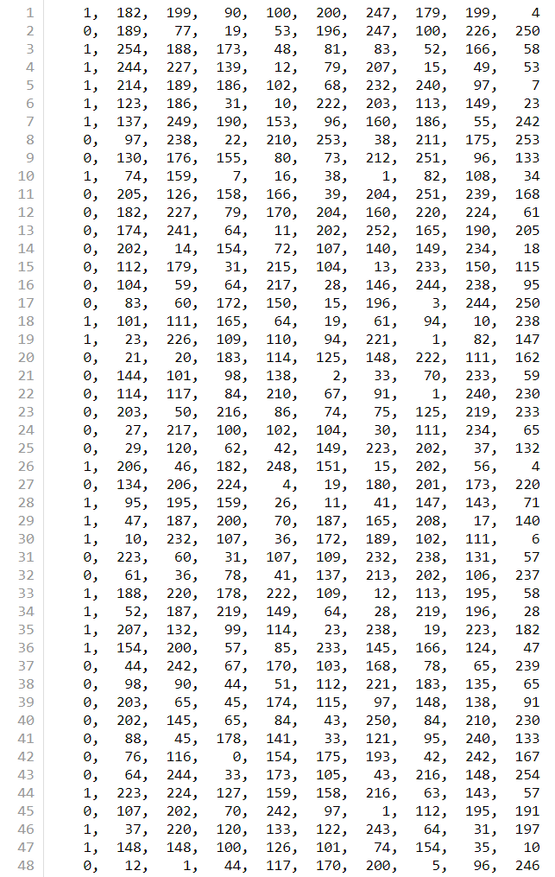


Slide 13
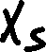
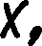
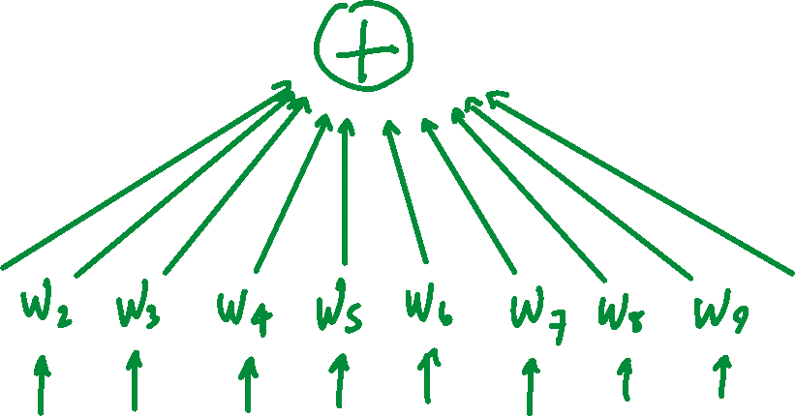
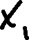

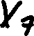

Slide 14
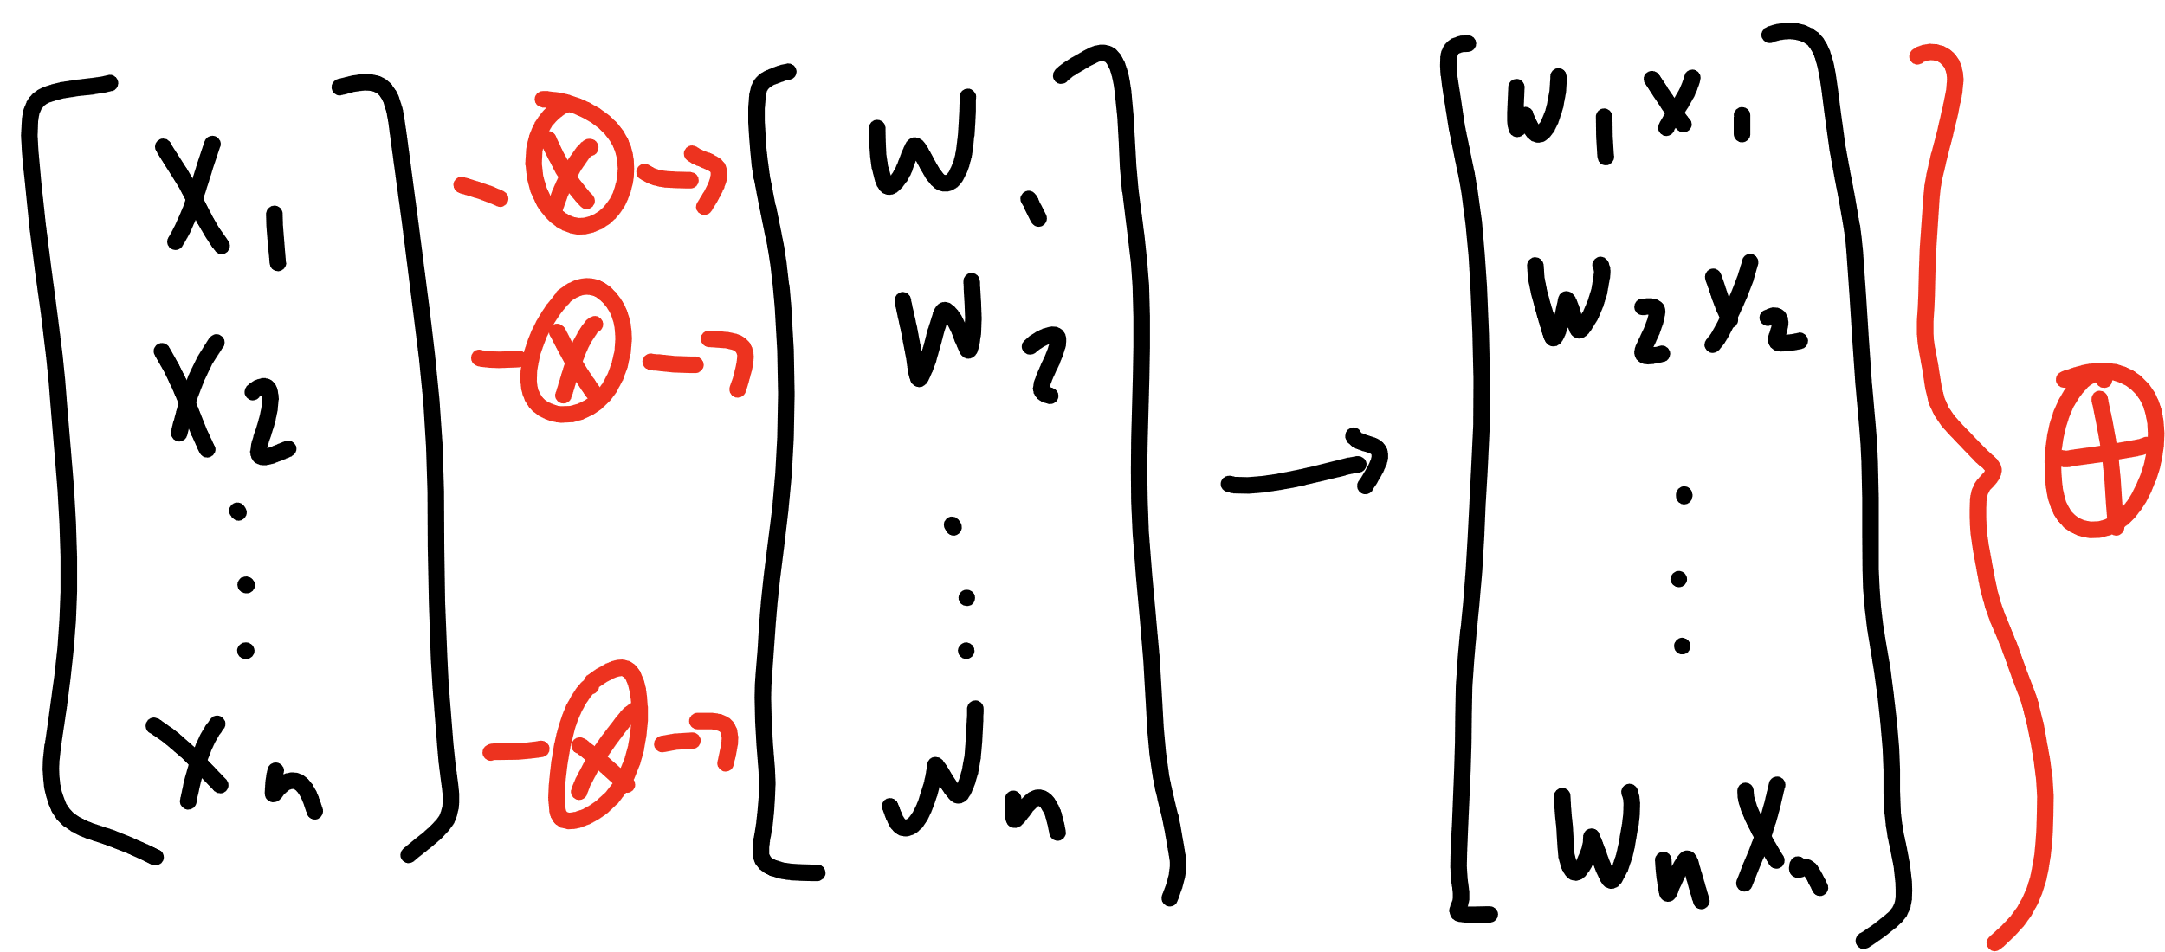

Slide 15
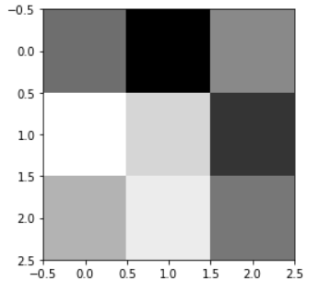
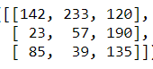
[142, 233, 120, 23, 57, 190, 85, 39, 135]

Slide 16
[ 1, 1, 1, 0, 0, 0, -1, -1, -1]
[142, 233, 120, 23, 57, 190, 85, 39, 135]
236

Slide 17
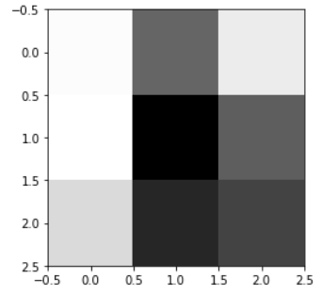
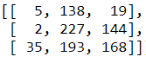
[5, 138, 19, 2, 227, 144, 35, 193, 168]

Slide 18
[ 1, 1, 1, 0, 0, 0, -1, -1, -1]
[5, 138, 19, 2, 227, 144, 35, 193, 168]
-234

Slide 19
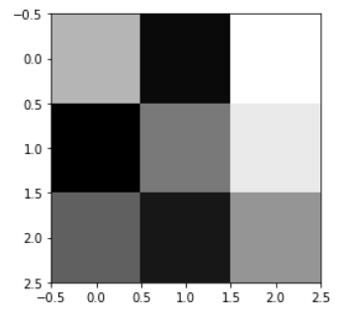








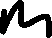


Slide 20






Slide 21












Slide 22










Slide 23

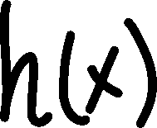







Slide 24











Slide 25
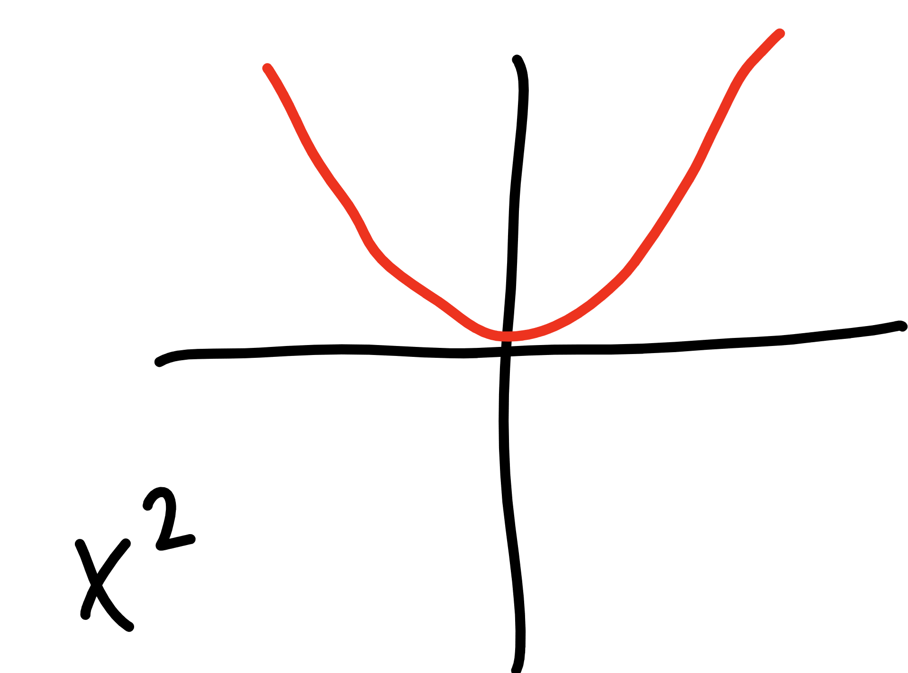

Slide 26
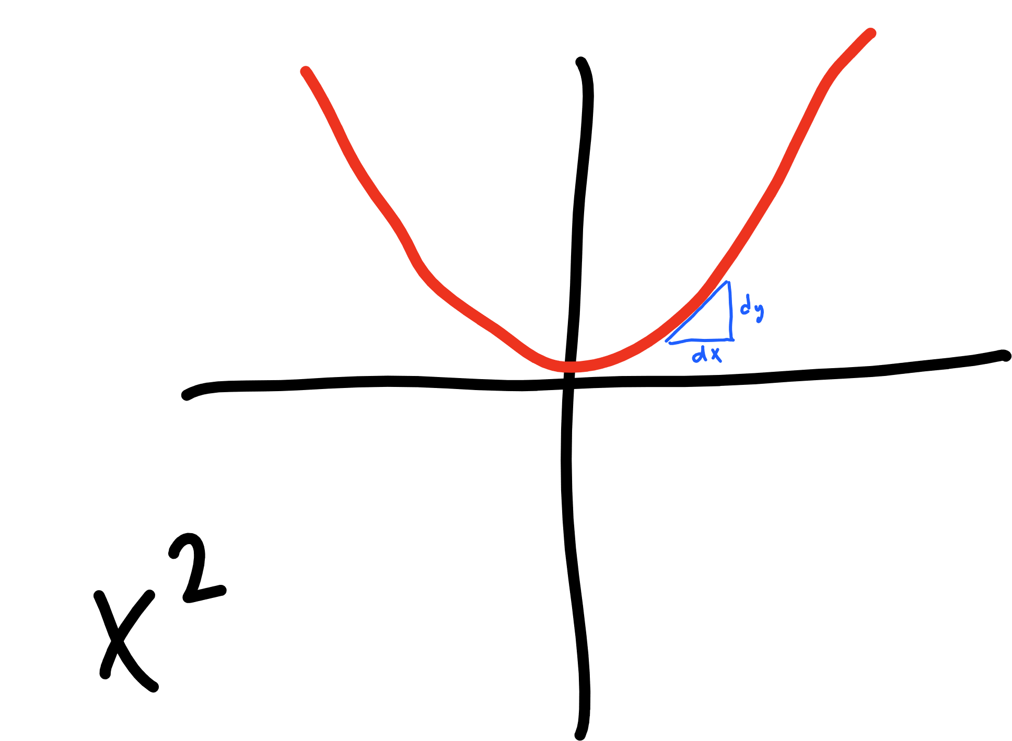

Slide 27
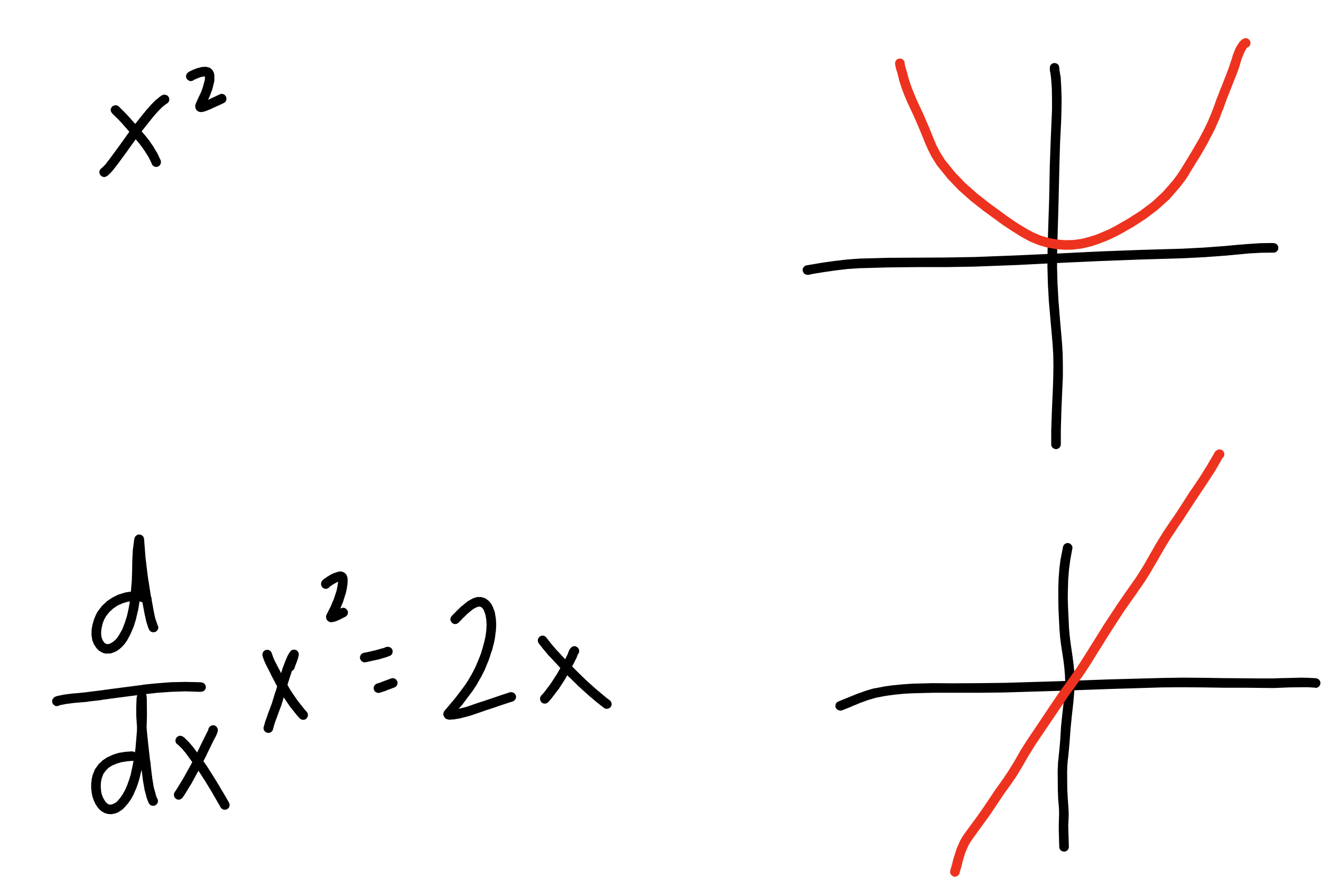


Slide 28







learning
rate
updated W
derivative of
cost function
current W

Slide 29

learning
rate
gradient of
cost function
updated W
current W

Slide 30








learning
rate
gradient of
cost function
updated W
current W

Slide 31


learning
rate
gradient of
cost function
updated b
current b

Slide 32



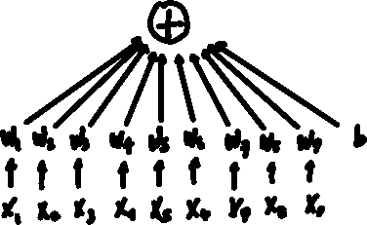

top
middle
bottom

Slide 33
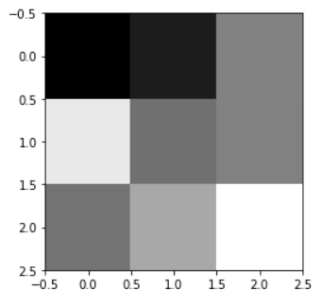
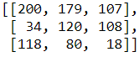




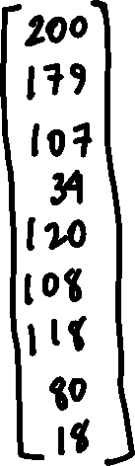


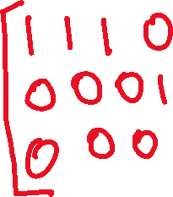
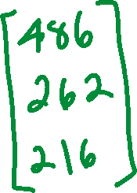

Slide 34






Slide 35
PyTorch
a primer for devs

Slide 36
PyTorch Overview
Data
Tensors
Datasets
DataLoaders
Models
Model Function
Loss
Optimization
Inference
Saving / Lording Models

Slide 37
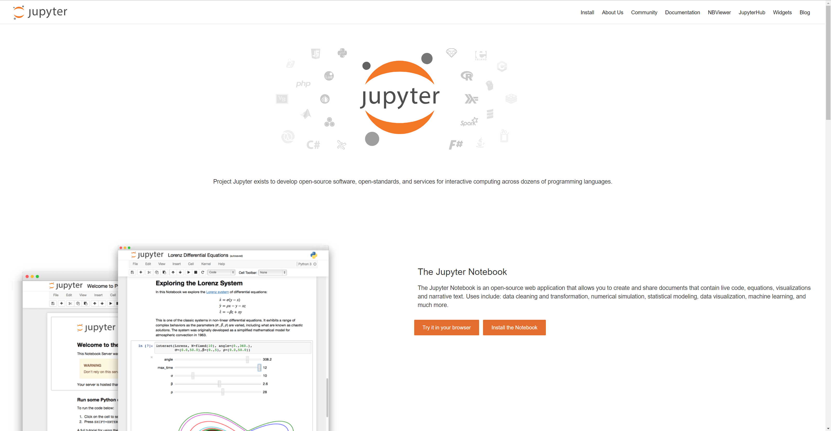

Slide 38
Tensors

Slide 39
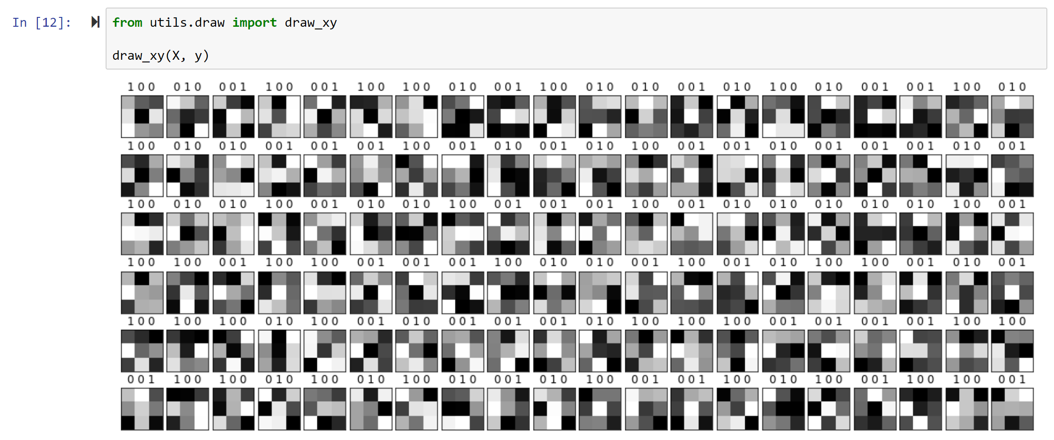

Slide 40
Tensors
PyTorch Tensors are special

Slide 41
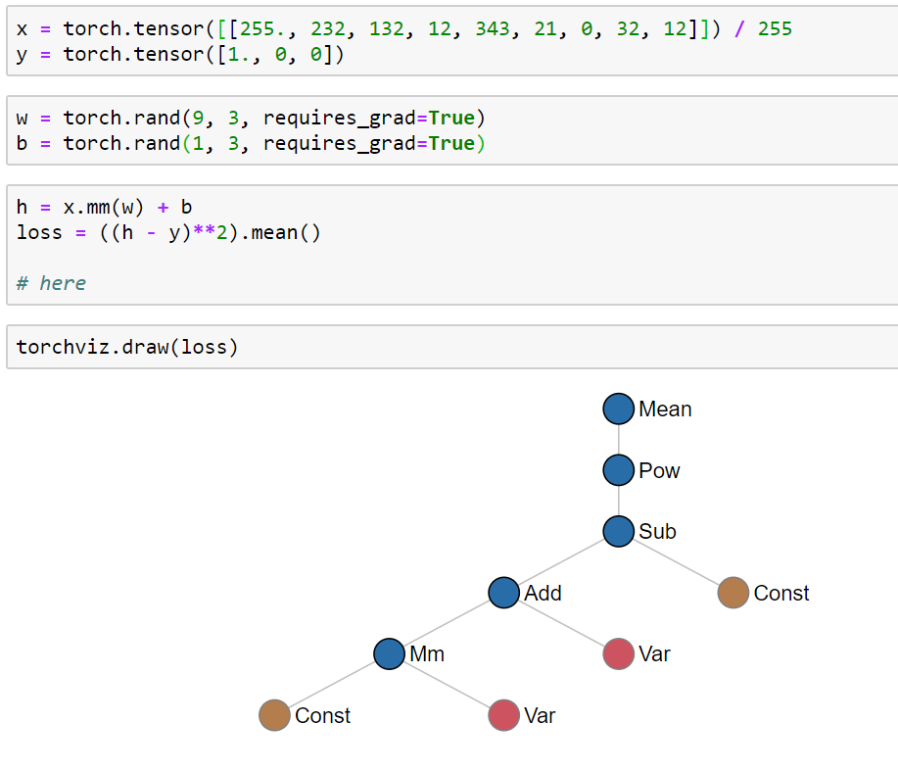

Slide 42
DataSets and DataLoaders

Slide 43
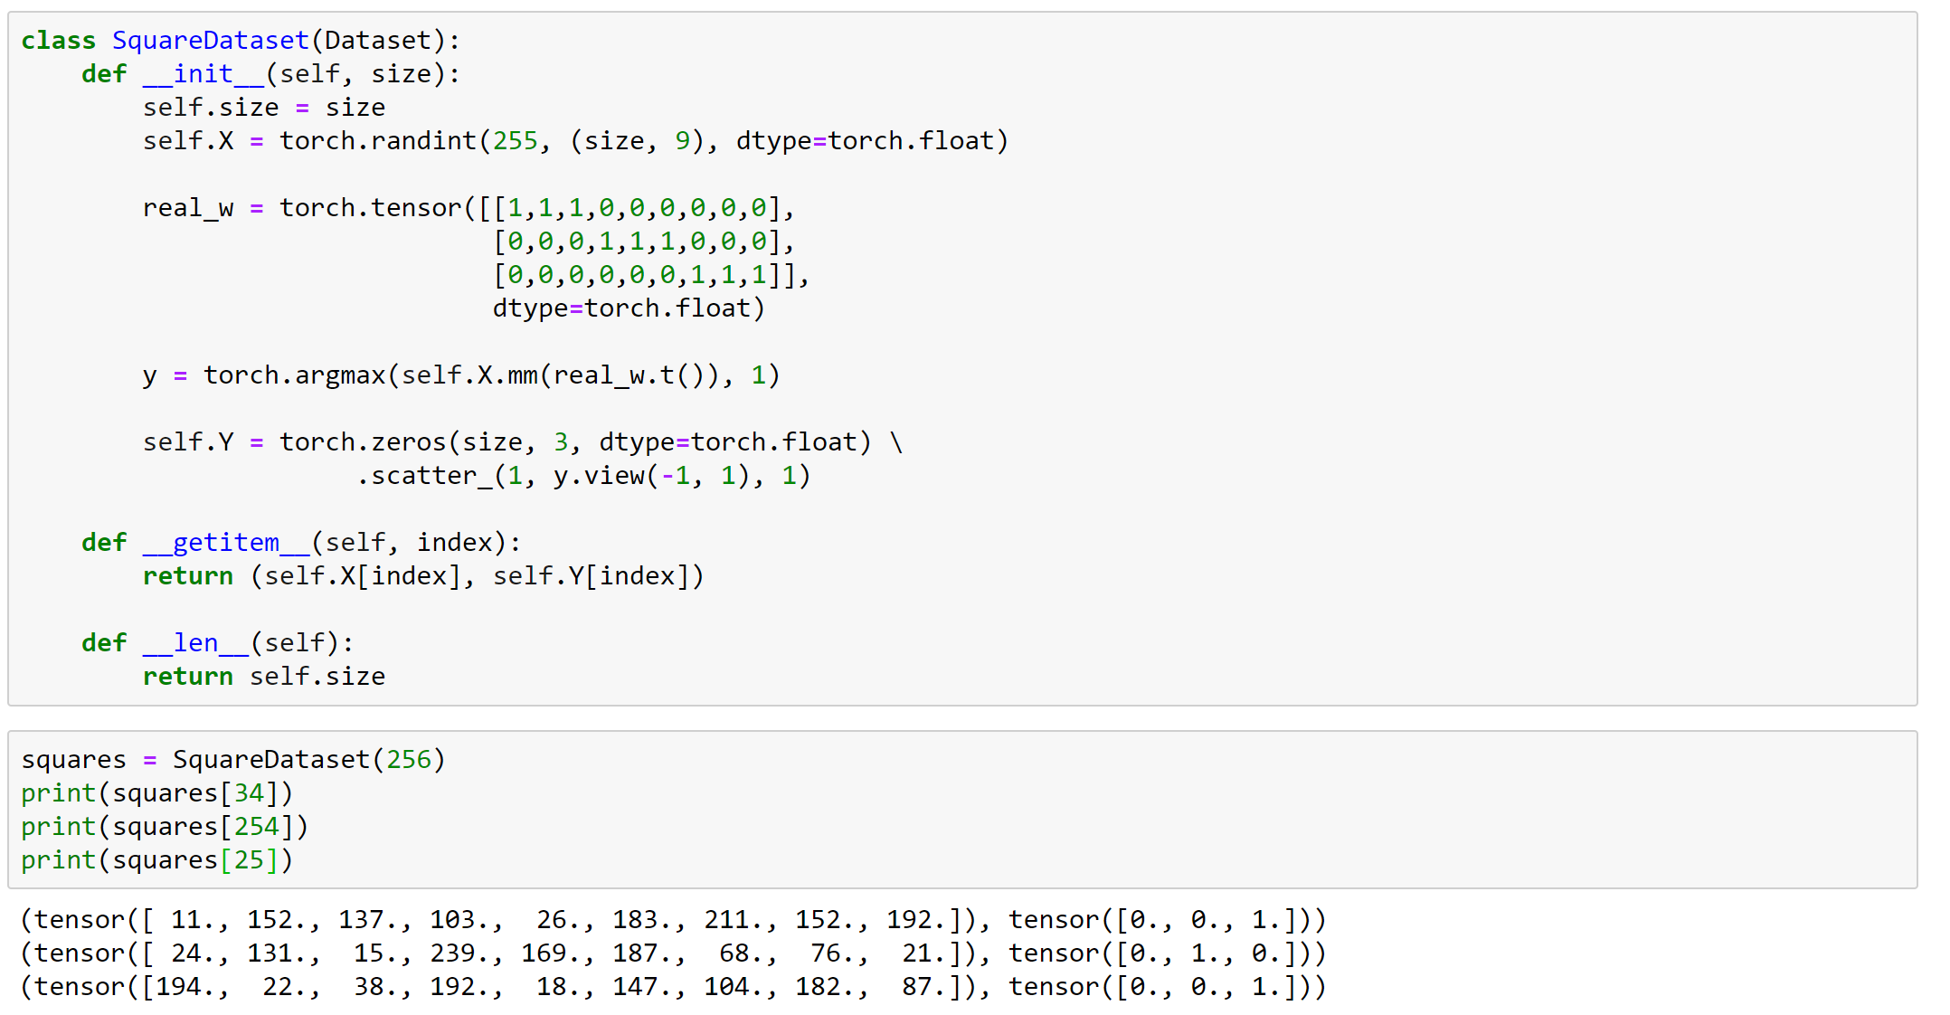

Slide 44
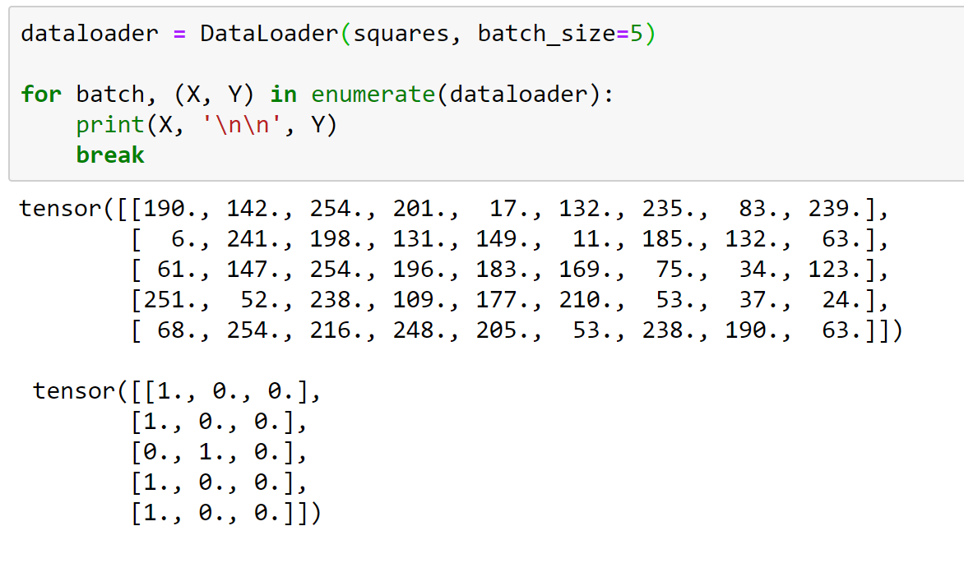

Slide 45
Models and Loss (…or Cost)

Slide 46
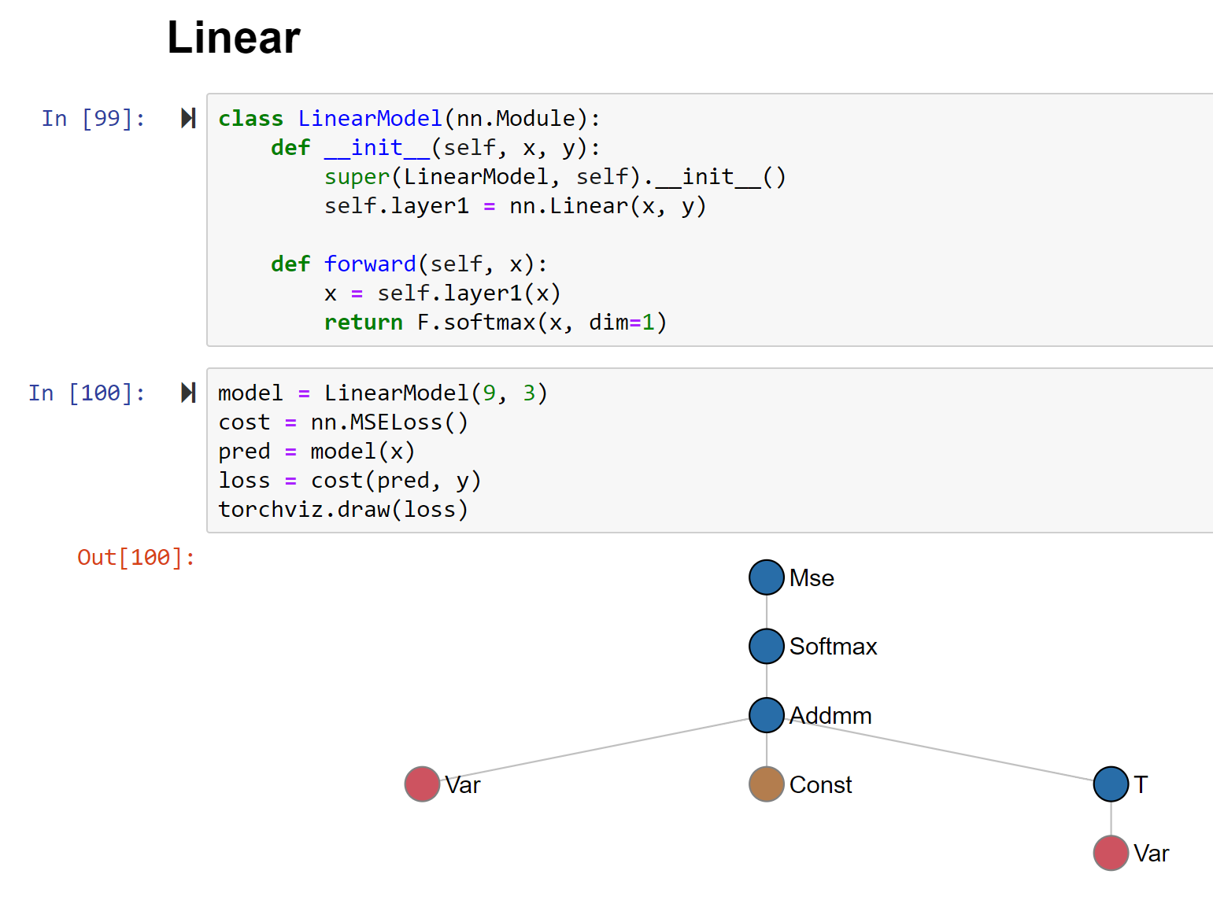

Slide 47
Optimization
The Loop!

Slide 48
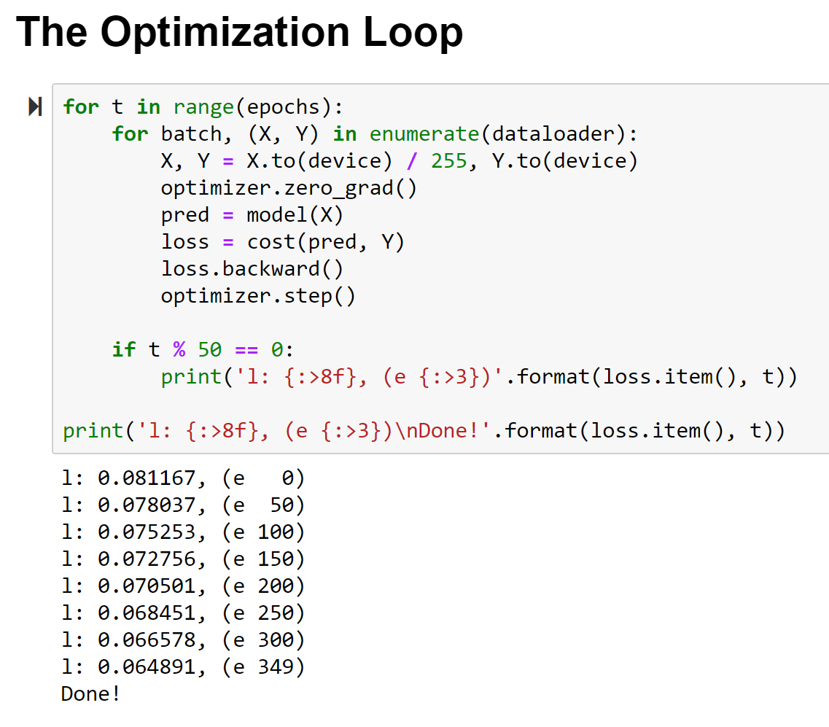

Slide 49
Inference
Using the model…

Slide 50
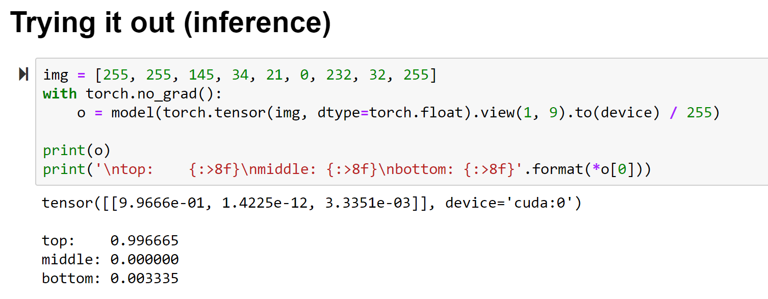

Slide 51


Slide 52


Slide 53
Digits tho…

Slide 55






Slide 56
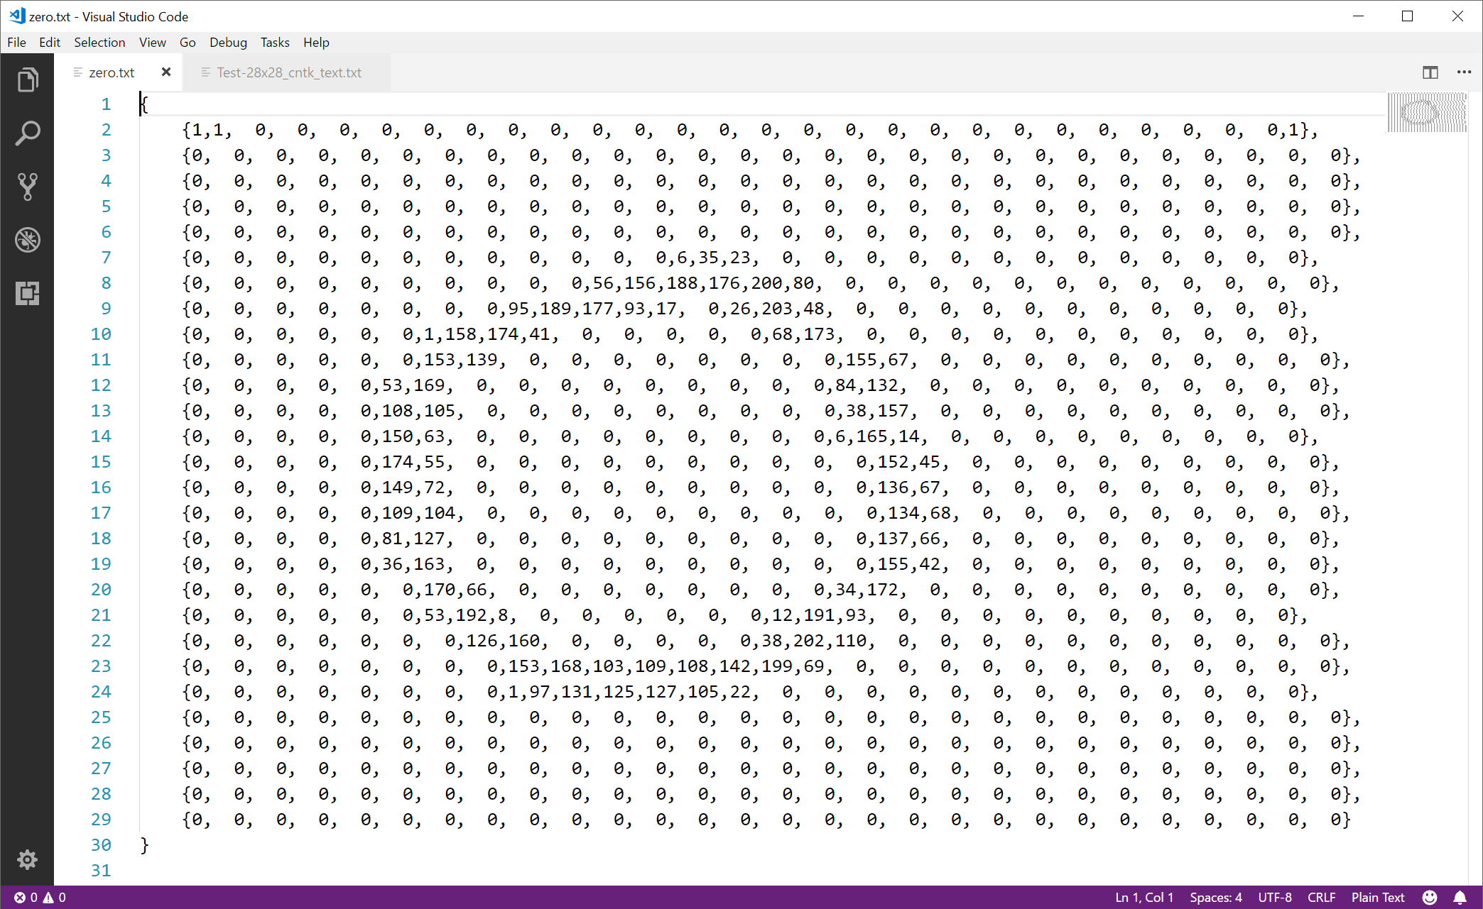

Slide 57
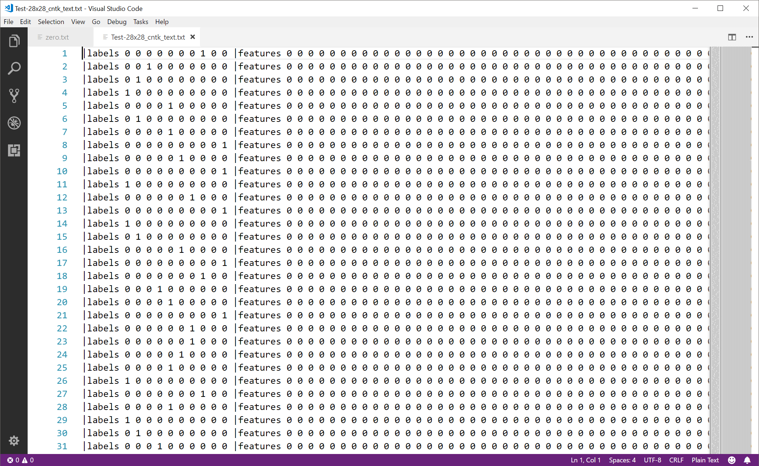

Slide 59
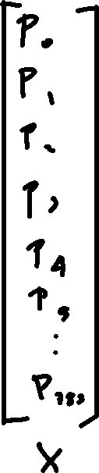
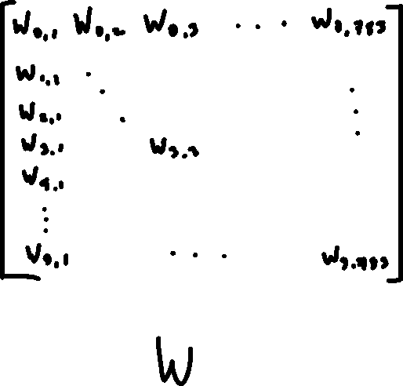
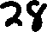


Slide 60


Slide 61
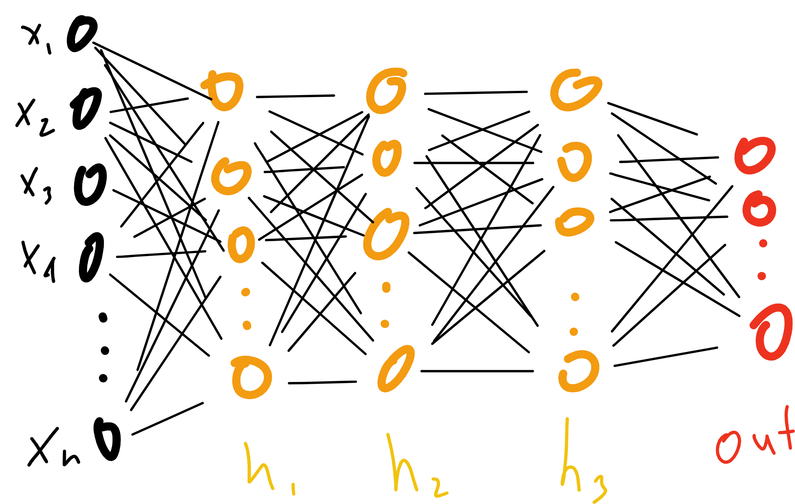

Slide 62
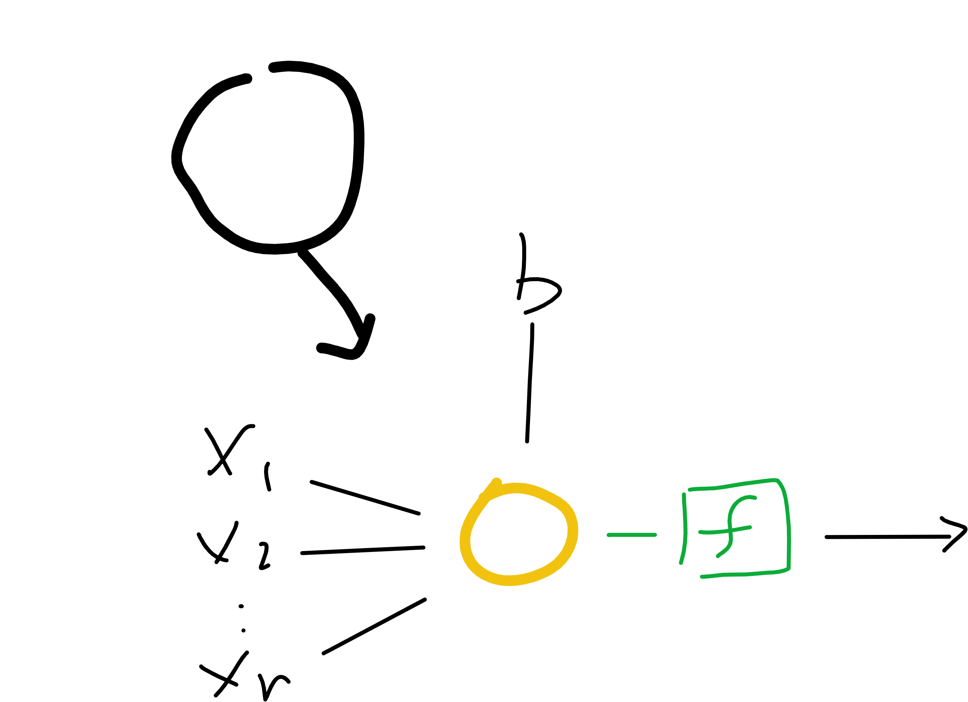
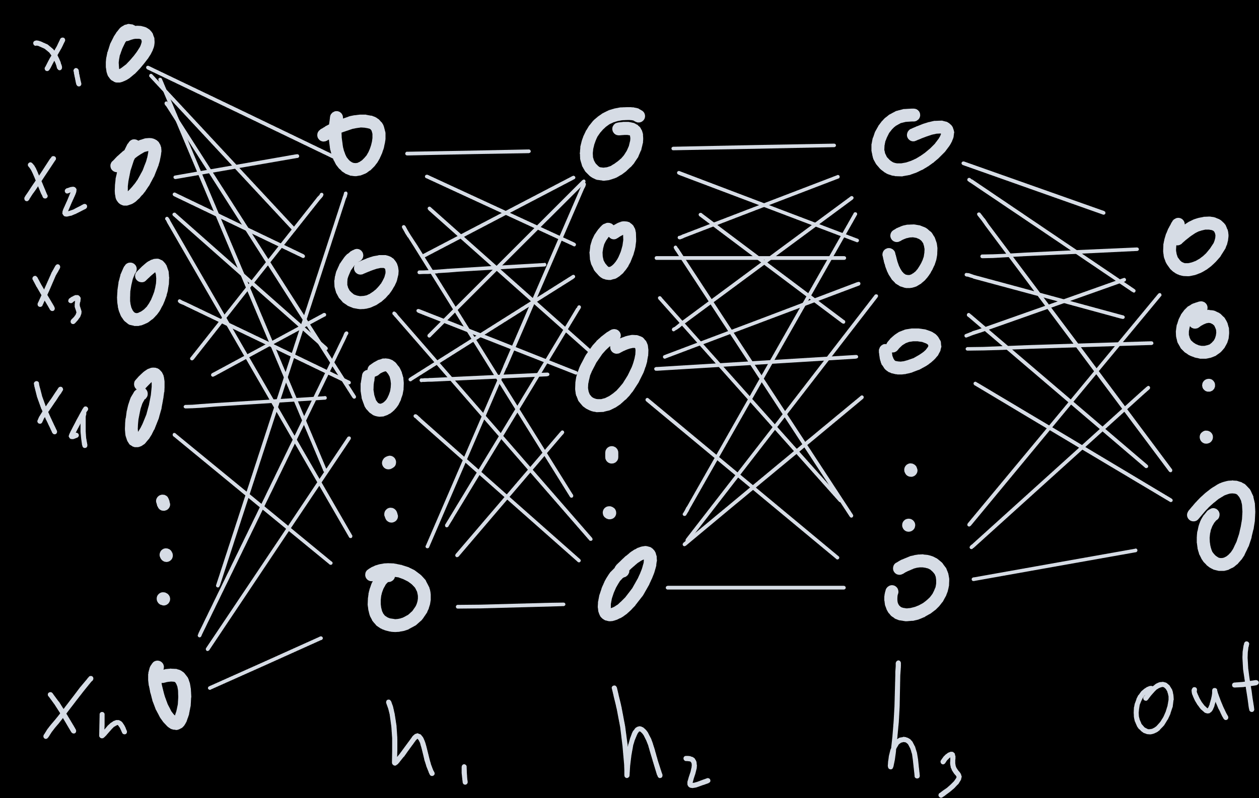
Notes:
Proof by induction

Slide 63
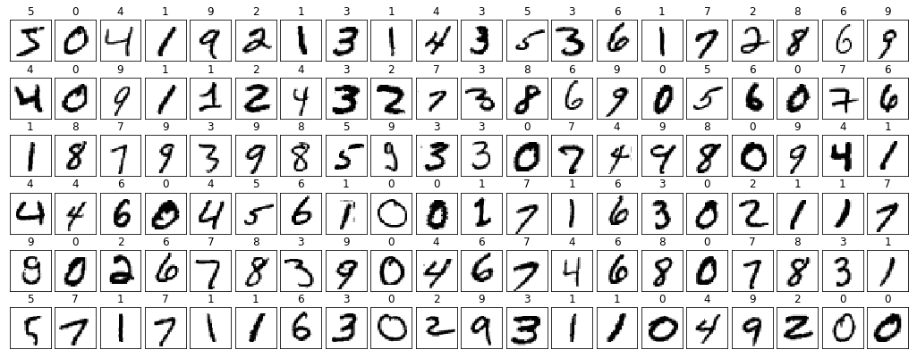
Notes:
Derivative?
Architecture

Slide 64
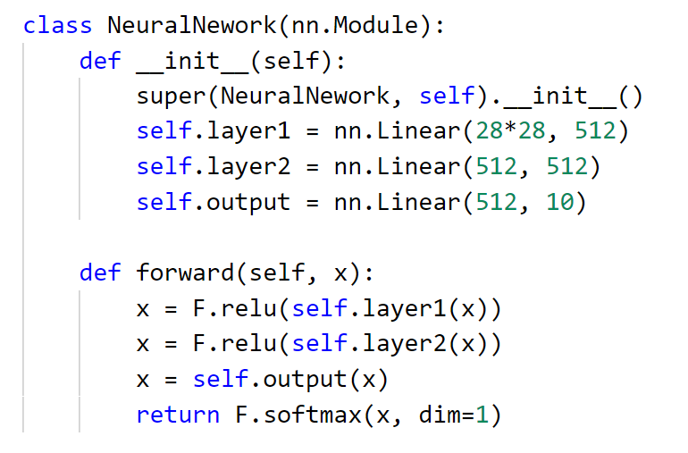

Slide 65
Better Network…

Slide 66
filters and pooling

Slide 67
filters
2 | 4 | 9 | 1
6 | 3 | 5 | 7
2 | 8 | 2 | 4
9 | 7 | 3 | 6
1 | 1 | 1
0 | 0 | 0
-1 | -1 | -1
3 | 0
-5 | -1

Slide 68
padding
0 | 0 | 0 | 0 | 0 | 0
0 | 2 | 4 | 9 | 1 | 0
0 | 6 | 3 | 5 | 7 | 0
0 | 2 | 8 | 2 | 4 | 0
0 | 9 | 7 | 3 | 6 | 0
0 | 0 | 0 | 0 | 0 | 0
-9 | -14 | -15 | -12
-4 | 3 | 0 | 7
-7 | -5 | -1 | 3
10 | 12 | 14 | 6
1 | 1 | 1
0 | 0 | 0
-1 | -1 | -1

Slide 69
pooling
-9 | -14 | -15 | -12
-4 | 3 | 0 | 7
-7 | -5 | -1 | 3
10 | 12 | 14 | 6
3 | 7
12 | 14

Slide 70
Notes:
Derivative?
Architecture

Slide 71
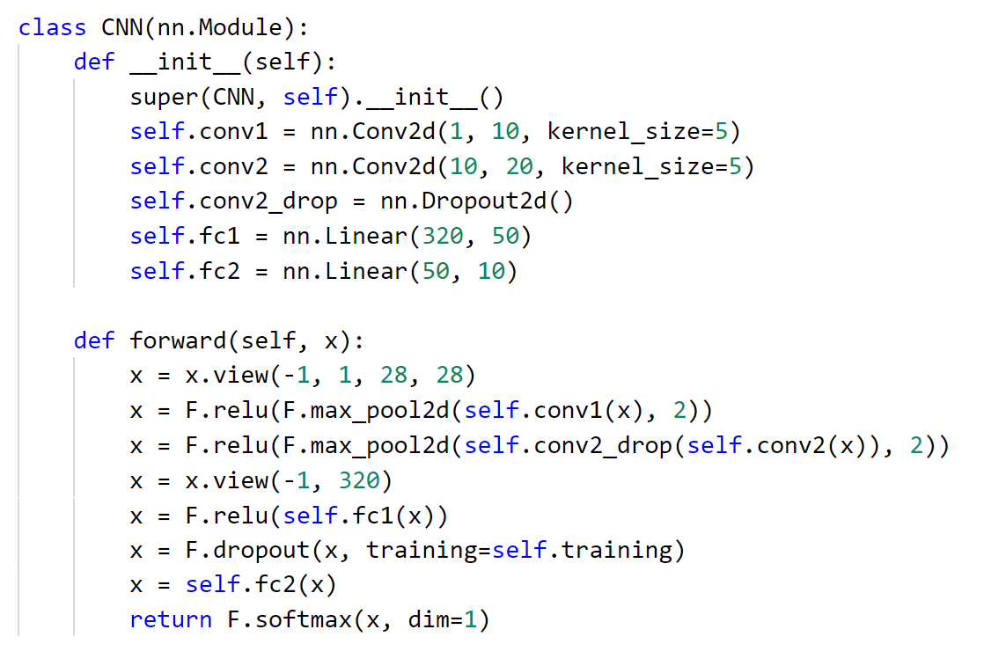

Slide 72
Putting it all together
a full run through to production

Slide 73
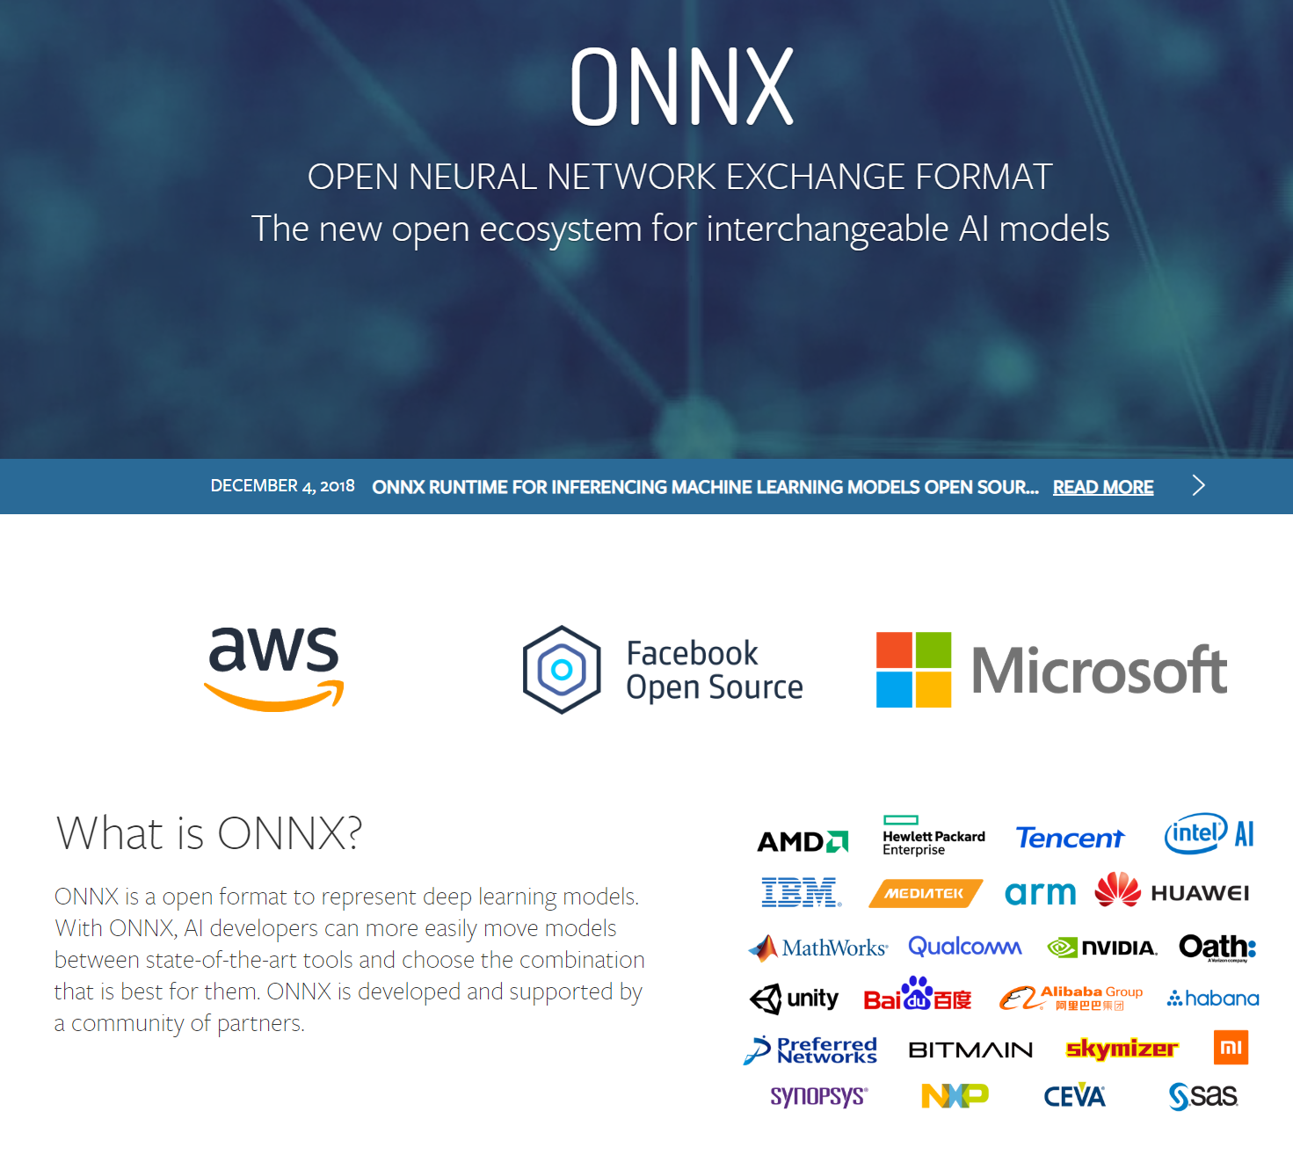

Slide 74
Handwriting Demo

Slide 75
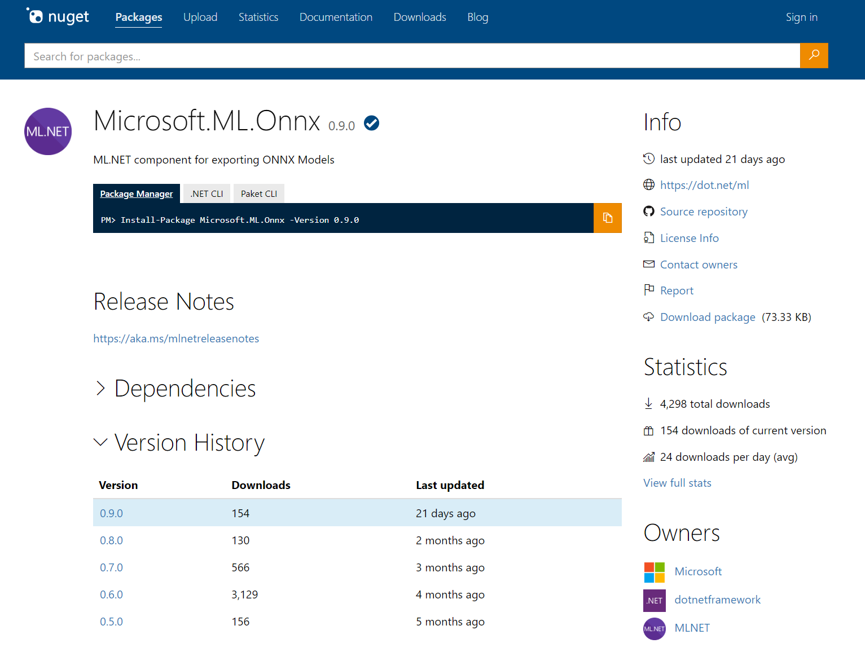

Slide 76






Azure Machine Learning service
Notes:
Experiments – this is where you try stuff / will have a history / track code through snapshots for every run / keep sanity (metadata)
Data Stores – where does your data live – MNIST is fine until it doesn’t fit on your hard drive, you also need to share with others, and you spilt your coffee once on your machine and lost everything
Compute – the metal where the experiments run (physical run on compute)
Models – output (just the good ones – you specify what to keep and how to version)
Images – package model with inference code and everything you need for it to run properly
Deployments – actual running models with ip addresses and everything

Slide 77
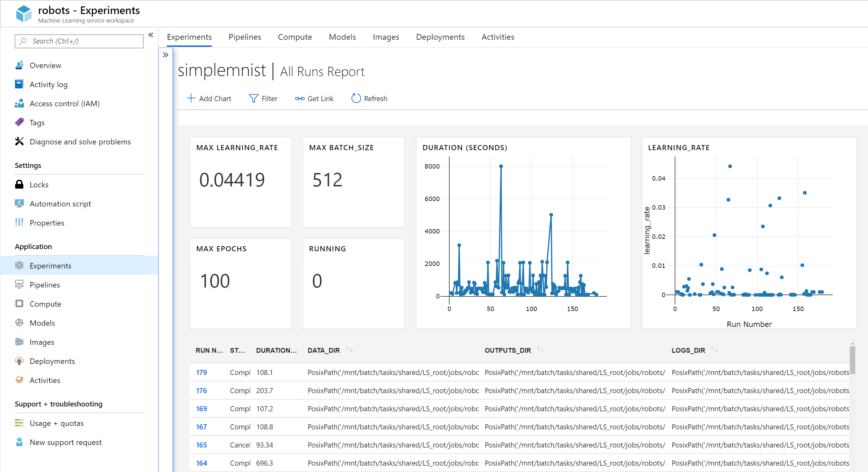

Slide 78
summary
Deep Learning Principles
input
model function
cost function
optimization method
PyTorch
Tensors, DataSets, DataLoaders
Models, Loss, Optimization
Inference
ONNX, Azure Machine Learning service

Slide 79
summary
Learn more about
Microsoft AI – https://aka.ms/aidevdocs
Cognitive Services – https://aka.ms/cogsvcs
Azure ML – https://aka.ms/azuremldocs
Deep Learning VMs – https://aka.ms/dlvmdocs
Code
https://github.com/sethjuarez/DeepLearningWithPyTorch
Get a hold of me!
seth.juarez@microsoft.com
@sethjuarez

Slide 80

Seth Juarez
Microsoft
@sethjuarez

